Slide 1


2025 Miss Jabberwock Interest Meeting
Sponsored by
Greensboro Alumnae Chapter
Delta Sigma Theta Sorority, Incorporated ™
Jabberwock Tri-Chairs
Tamara Caple, DNP
Teresa Lipscomb-Burney
Karen Martin-Jones, Ph.D.
Jabberwock Parent Liaison
Anessa Burgman, Ed.D.
Saturday, September 14, 2024
Noon
Desirée F. Best
GAC President
336-706-8146 25gacpresident@gmail.com

Slide 2

GETTING TO KNOW YOU
Introduce yourself:
  Your name
  Your school
  Who is here with you today?
  One interesting fact

Slide 3
Jabberwock is…
A cultural enrichment activity distinctive to Delta Sigma Theta Sorority, Inc.;
A fundraising activity sponsored by Delta chapters across the United States since 1925;
A gala event for high school seniors to compete for scholarships and other awards
The title is taken from Lewis Carroll’s tale, Alice’s Adventures in Wonderland.

Slide 4
  Major Components of the Jabberwock Experience
  Cultural Enrichment Activities
  Community Service Projects
  Fundraising
  Talent Presentation
  Jabberwock Pageant
  **Jabberwockettes are encouraged to participate in all five components.**

Slide 5
Jabberwock Activities
  Parent/Jabberwockette Meetings
  Bonding Activities
  Introduction of Jabberwockettes and Parents at Chapter Meeting
  Community Service Projects
  Fundraising
  Father/Daughter Event
  Mother/Daughter Event
  Talent Rehearsals & Presentation
  Pageant Rehearsals & Pageant Presentation

Slide 6
Jabberwock Subcommittees Chair(s)
  Awards
  Bonding
  Community Service
  Decorations
  Father/Daughter
  Mother/Daughter
  Finance
  Pageant
  Parade
  Parent Liaison
  Photography
  Souvenir Booklet
  Talent Presentation
  Ushers

Slide 7
Eligibility/General Program Rules and Guidelines
  All Jabberwockettes are expected to attend at least 70% of the personal development activities that have been planned. If a Jabberwockette is unable to attend a scheduled activity, she should contact the subcommittee chair(s) of that particular event.
  Rehearsals are extremely important. If a Jabberwockette is unable to attend a scheduled rehearsal, she must notify the subcommittee chair(s) of the event.
  Talent rehearsals will be on Sundays from 3-5 p.m, between Oct. 13-Jan. 25 (~10 rehearsals). Pageant rehearsals will be on Sundays from 3-5 p.m. with most rehearsals occurring between Feb. 2-Apr. 5 (~10 rehearsals including day of pageant).
  Jabberwockettes, parents, escorts, and ushers must complete a risk management training. Forms must be completed and submitted for the chapter’s file.
  Participation fee of $850 due December 8, 2024.

Slide 8
Jabberwock Application Process
  Submit a completed Jabberwock application.
  Submit one letter of recommendation from a school counselor, teacher, church member, or member of Delta Sigma Theta Sorority, Inc.
  Submit an official high school transcript indicating a minimum 2.5 weighted GPA in a sealed envelope.
  Submit a non-refundable application fee of $150 (check or money order) payable to Greensboro Alumnae Chapter of Delta Sigma Theta Sorority, Inc. (GAC).
  Submit and complete the withdrawal contract.

Slide 9
Withdrawal Process
  Withdrawal contract must be included in packet.
  Any decision to withdraw must be in writing and all monies and materials will be immediately turned over to the Sorority.
  If participant withdraws, the participation fee will not be returned.
  If a participant withdraws, the withdrawn participant will request a scholarship check.
  If participant chooses to withdraw and a contributor requests the monies to be reimbursed, the participant and parent will assume that responsibility.
  Please read the withdrawal contract and ensure that it is signed before submitting.

Slide 10

Fundraising & Souvenir Book
  A specific number of souvenir books will be printed based on budget in addition to the possibility of an electronic copy
  Souvenir book will include names only, no ads.
  Sponsor Levels
  Platinum $300 and above
  Pearl $100 - $299
  Ruby $75 - $99
  Diamond $50 - $74
  Gold $25 - $49
  Patron $10 - $24
  Donation $9.99 and under
Donations will not be printed in the
souvenir book.

Slide 11

  The crowning of Miss Jabberwock is determined by calculating the total amount raised by each young lady. The Jabberwockette who raises the most money by the designated deadline will win the title of Miss Jabberwock 2025.
  The Jabberwock Pageant showcases all the young ladies; however, the three Jabberwockettes who raise the most money will be awarded as follows:
  3ʳᵈ Place
  2ⁿᵈ Place
  Miss Jabberwock 2025

Slide 12

  Scholarship Check
GAC will work in partnership with the Delta Research and Educational Foundation (DREF). Jabberwockettes will receive all of the money that is raised on their behalf and will need to provide a copy of their acceptance letter and school schedule from their college/university before a scholarship check is written. The check will be made payable to the school of her choice.
A Jabberwockette may request a check from DREF for undergraduate or graduate studies.

Slide 13
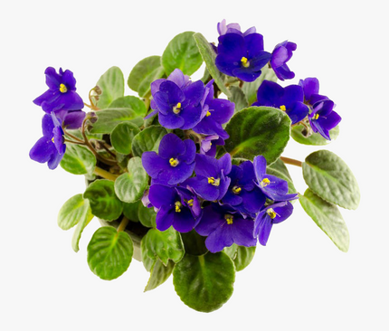
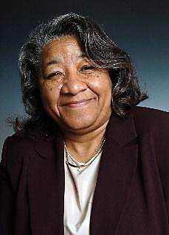
  The Kay Harris Spirit Award will be awarded to a Jabberwockette selected by her peers. The recipient must have demonstrated dedication and a genuine interest in the pageant's activities, must be respected by her peers, and must have shown a willingness to assist and encourage others throughout the pageant. Receiving the Kay Harris Spirit Award is a true honor based on the character of its namesake, Kay Harris. Kay was a member of the Greensboro Alumnae Chapter. She was kind, hard working, and always represented herself as a true lady. Kay had a contagious smile and always looked for the good qualities in her peers and the students she counseled. She is truly missed.
The Kay Harris Spirit Award

Slide 14
Items Needed for a Complete Jabberwock Packet
  Completed application form
  Completed withdrawal contract
  Sealed school transcript (2.50 GPA - weighted)
  One reference letter from counselor, principal, member of DST, church member, etc.
  Check/money order payable to Greensboro Alumnae Chapter for $150
  All materials above must be mailed to the following address listed below no later than September 30, 2024.
  Greensboro Alumnae Chapter Delta Sigma Theta Sorority, Inc.
  Attn: Jabberwock Committee
  P.O. Box 20284
  Greensboro, NC 27420

Slide 15
Greensboro Alumnae Website
  Go to (dstgac.org)
  Chapter Initiatives
  Jabberwock
  2024-25 Pageant Application (fillable document)
  2024-25 Pageant Withdrawal Contract (fillable document)
  Greensboro Alumnae Chapter Delta Sigma Theta Sorority, Inc.
  Attn: Jabberwock Committee
  P.O. Box 20284
Greensboro, NC 27420

Slide 16
Upcoming/Important Dates to Note
  Application and Monies Due
  via Mail
  Monday, September 30, 2024
  5 p.m.
Risk Management/Parent Meeting
  via Zoom
  Wednesday, October 9, 2024
  8 p.m.
Upcoming/Important Dates to Note
2025 Jabberwock Talent Presentation
  Location TBD
  Saturday, January 25, 2025
  4 p.m.
  2025 Miss Jabberwock Pageant Presentation
TBD
Both events are free and open to the public.

Slide 17

QUESTIONS
&
ANSWERS

Slide 18

Thank you for attending the 2025 Miss Jabberwock Pageant Interest Meeting. Please join us for light refreshments.

